Slide 1
Cash Allocation Model Report

Slide 2
Introduction
The Cash Allocation Model aims to leverage financial data from multiple sources to make informed decisions regarding cash allocation. The model computes essential metrics, including market volatility, traded volume, institutional flow, market breadth, and interest rates, to evaluate market conditions and optimize cash allocation strategies.

Slide 3
Data Sources and Justification
National Stock Exchange (NSE) - To gather data on Nifty 50, Nifty Midcap 100, and traded volumes, essential for assessing market volatility and trading activity.
Reserve Bank of India (RBI) - To obtain policy rates and reverse repo rates, which are critical for understanding the macroeconomic environment and liquidity conditions.
Securities and Exchange Board of India (SEBI) - To acquire institutional flow data (FII and DII), essential for evaluating market sentiment and investor behavior.
These data sources are chosen because they provide reliable, up-to-date information relevant to Indian financial markets, which is crucial for accurate cash allocation decisions.

Slide 4
Historical Trend Visualization
Below are some key historical trends analyzed during the modeling process:
Market Volatility Trends: 30-day rolling volatility for Nifty 50 and Nifty Midcap 100, indicating fluctuations in the market.
Institutional Flow Trends: Net FII and DII flows to capture investment patterns.
Market Breadth Trends: Advance-Decline ratios to assess market sentiment.
Interest Rate Trends: Policy and reverse repo rates over time, indicating the macroeconomic stance.

Slide 5
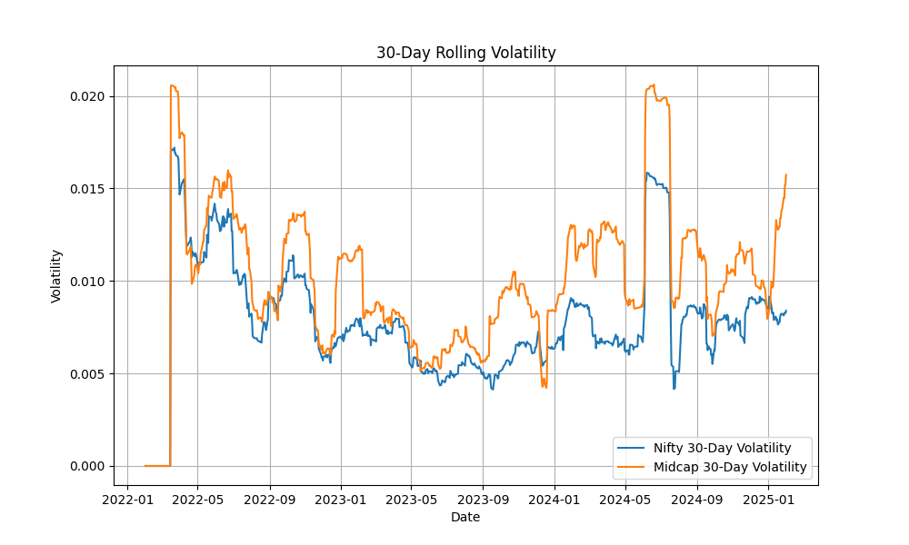

Slide 6
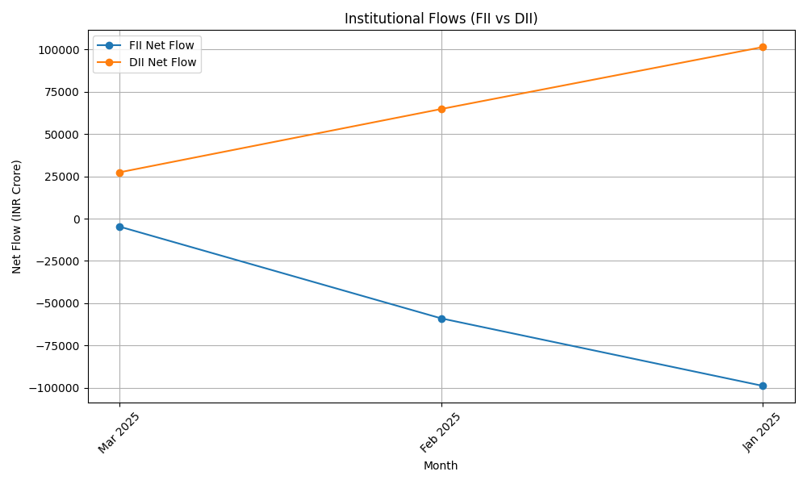

Slide 7
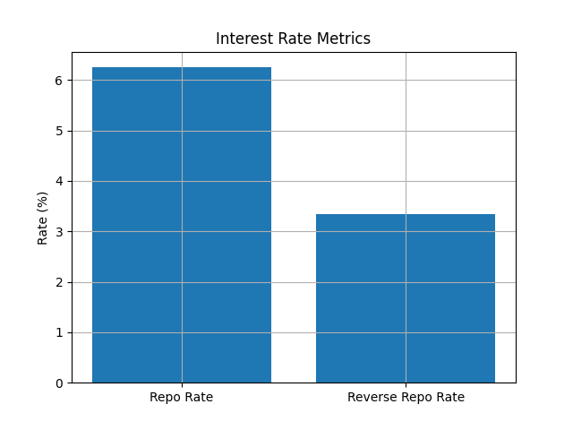

Slide 8
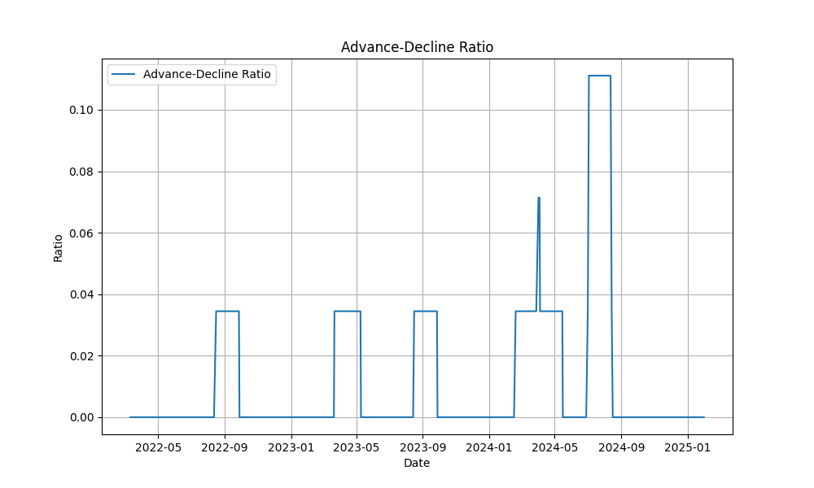

Slide 9
Feature Engineering Approach
The model employs a combination of rolling averages and ratio computations to derive features. Key feature engineering steps include:
Market Volatility Metrics: Calculation of 30-day rolling volatility and volatility ratios between Nifty 50 and Nifty Midcap 100.
Traded Volume Metrics: Calculation of the 30-day rolling average of traded volume for both indices.
Institutional Flow Metrics: Calculation of net flows for FIIs and DIIs, along with the FII/DII ratio.
Market Breadth Indicators: Calculation of the Advance-Decline ratio for Nifty 50.
Interest Rate Metrics: Extraction of policy and reverse repo rates from RBI data.

Slide 10
Model Methodology
The model integrates various engineered features and employs statistical techniques to assess the risk and determine optimal cash allocation. By analyzing market volatility, institutional flows, and macroeconomic indicators, the model computes a recommended cash percentage to mitigate risks during market downturns and capitalize on stable periods.

Slide 11
Results and Interpretation
Based on the latest data, the current recommended cash allocation percentage is X%. This value reflects the model's assessment of market risk and liquidity conditions. The recommendation aims to balance risk management while maintaining market exposure.

Slide 12
Limitations and Future Improvements
Data Availability: Limited real-time data access may impact prediction accuracy.
Model Adaptability: Incorporating additional asset classes and macroeconomic variables could enhance the model’s robustness.
Alternative Modeling Techniques: Exploring machine learning techniques may improve prediction accuracy and interpretability.

Slide 13
Conclusion
The Cash Allocation Model provides a data-driven approach to determining optimal cash allocation by leveraging reliable financial data and statistical techniques. Future improvements could focus on model adaptation and integration of additional data sources for enhanced performance.

Slide 14
Thank You

